Slide 1


HYU-SE-2023
TEAM BloomMate

Slide 2
Contents
01.
Introduction
03.
Scenario 2
- Motivation
- Problem & Solution
[Visit Smart Cottage to check plants]
- Update & Harvest plant
- Diagnose plant
- Use community
02.
Scenario 1
04.
Scenario 3
[planting for the first time]
- Sign Up
- Log-in
- Add plant
- Check plant details
[Chatting with plants in own home]
- Chat with plants
Notes:
Hello World

Slide 3
01
Introduction
Motivation
As the time spent at home increased due to COVID-19, the hobby of growing plants became popular. The industry related to this has grown significantly.
(Unit: billion)
Fig 1. Home Gardening Industry Revenue Rises
20%
gardening supplies
flowerpot
seedling
92%
48%
Fig 2. Expansion of Plant Growers Market

Slide 4


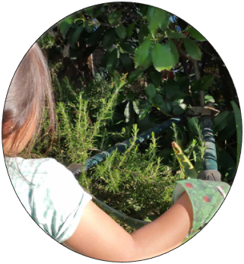
01
Introduction
Problem & Solution
LG Smart Cottage:
absence of home turf
Rasing Plants:
absence of communication
Brown Thumb

Slide 5



01
Introduction
Problem & Solution
Meeting the needs of more customers
Brown thumb turns into green thumb with LG
Build a bond with plants

Slide 6
02
Scenario 1
Scenario 1
“planting for the first time”
- Sign Up
- Log-in
- Add plant
- Check plant details

Slide 7
03
Scenario 2
Scenario 2
“Visit Smart Cottage to check plants”
- Update & Harvest plant
- Diagnose plant
- Use community

Slide 8
04
Scenario 3
Scenario 3
“Chatting with plants in own home”
- Chat with plants

Slide 9




00
Reference
video link: https://www.youtube.com/watch?v=hUYt6bMIOu4
notion: https://bloommate.notion.site/
github: https://github.com/BloomMate
Blog: https://medium.com/@akainoo/bloommate-project-blog-f7e30e2f57ff

Slide 10

TEAM BloomMate
Dept. of Information systems
An Soonho, Kim Donghyun, Yoon Yongsung, Shin Hyunah
Thank You

